Slide 1
Lending Club Case Study
ML C54 June 2023 EPGP
Rajaram Karanth

Slide 2
Problem Statement
A consumer finance company which specialises in lending various types of loans to urban customers. When the company receives a loan application, the company has to make a decision for loan approval based on the applicant’s profile. Two types of risks are associated with the bank’s decision:
If the applicant is likely to repay the loan, then not approving the loan results in a loss of business to the company
If the applicant is not likely to repay the loan, i.e. he/she is likely to default, then approving the loan may lead to a financial loss for the company
Aim of this case study is to use EDA over the dataset containing the complete loan data for all loans issued through the time period 2007 to 2011 and assess the driving factors behind the loan default. such that the company can utilise this knowledge for its portfolio and risk assessment.
In this analysis, EDA is used to understand how consumer attributes and loan attributes influence the tendency of default.

Slide 3
Analysis Approach
Data Cleaning:
The dataset was checked for missing or invalid values in the rows and columns and fixed
mths_since_last_delinq column has 25682 NA values. Replaced with zero
mths_since_last_record column has 36931 NA values. Replaced with zero
desc column has 13149 blank values. However, those have corresponding valid purpose column values
next_pymnt_d column has 38577 blank records
The dataset was checked for unwanted columns and deleted. Below are the columns deleted that only had values as either NA or 0.
mths_since_last_major_derog, annual_inc_joint, dti_joint , verification_status_joint , acc_now_delinq , tot_coll_amt , tot_cur_bal , open_acc_6m , open_il_6m , open_il_12m , open_il_24m , mths_since_rcnt_il, total_bal_il, il_util , open_rv_12m , open_rv_24m, max_bal_bc , all_util , total_rev_hi_lim , inq_fi , total_cu_tl, inq_last_12m , acc_open_past_24mths , avg_cur_bal , bc_open_to_buy , bc_util , chargeoff_within_12_mths, delinq_amnt , mo_sin_old_il_acct , mo_sin_old_rev_tl_op , mo_sin_rcnt_rev_tl_op , mo_sin_rcnt_tl , mort_acc , mths_since_recent_bc , mths_since_recent_bc_dlq , mths_since_recent_inq , mths_since_recent_revol_delinq, num_accts_ever_120_pd , num_actv_bc_tl , num_actv_rev_tl , num_bc_sats , num_bc_tl , num_il_tl , num_op_rev_tl , num_rev_accts , num_rev_tl_bal_gt_0 , num_sats , num_tl_120dpd_2m , num_tl_30dpd , num_tl_90g_dpd_24m , num_tl_op_past_12m , pct_tl_nvr_dlq , percent_bc_gt_75, tot_hi_cred_lim , total_bal_ex_mort , total_bc_limit , total_il_high_credit_limit

Slide 4
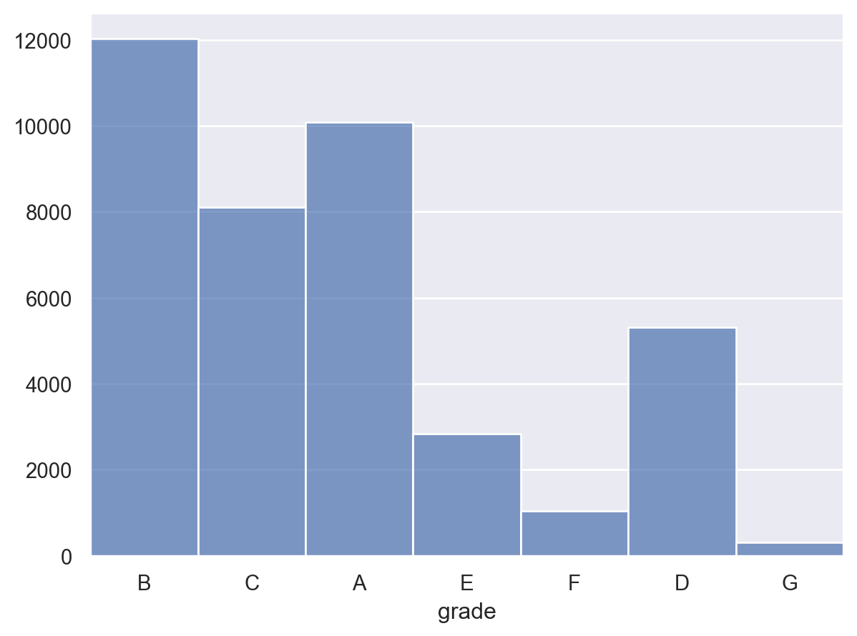
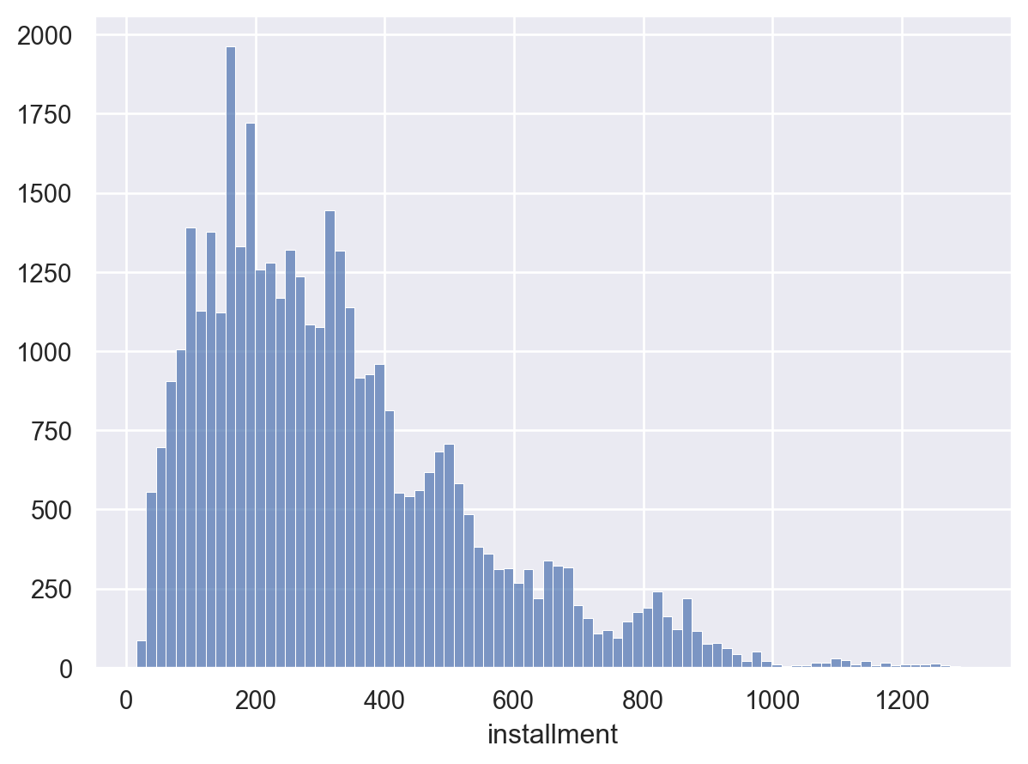
Analysis Approach – key characteristics of the loans issued
Univariate Analysis #1 - number of loans by grade
Univariate Analysis #2 - loan installments preferred
Highest number of loans disbursed are of grade B, followed by grade A
Highest bins installments opted are between 0 - 200 months and 200 - 400 months.

Slide 5
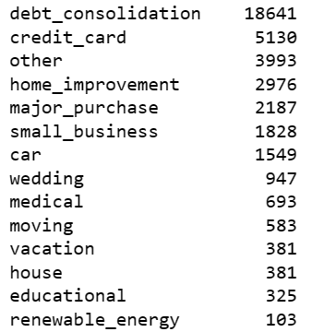
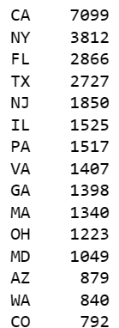
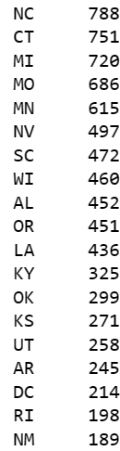
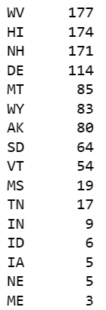
Analysis Approach – key characteristics of the loans issued
Univariate Analysis #3 - Purpose for which most of the loans are taken
Univariate Analysis #4 - States where maximum number of loans disbursed
Maximum number of loans taken are for the purpose of debt consolidation. More chances of default in this category as this option just provides breathing time for otherwise a possible delinquent loan in the previous institution
Most number of loans are issued in big cities

Slide 6
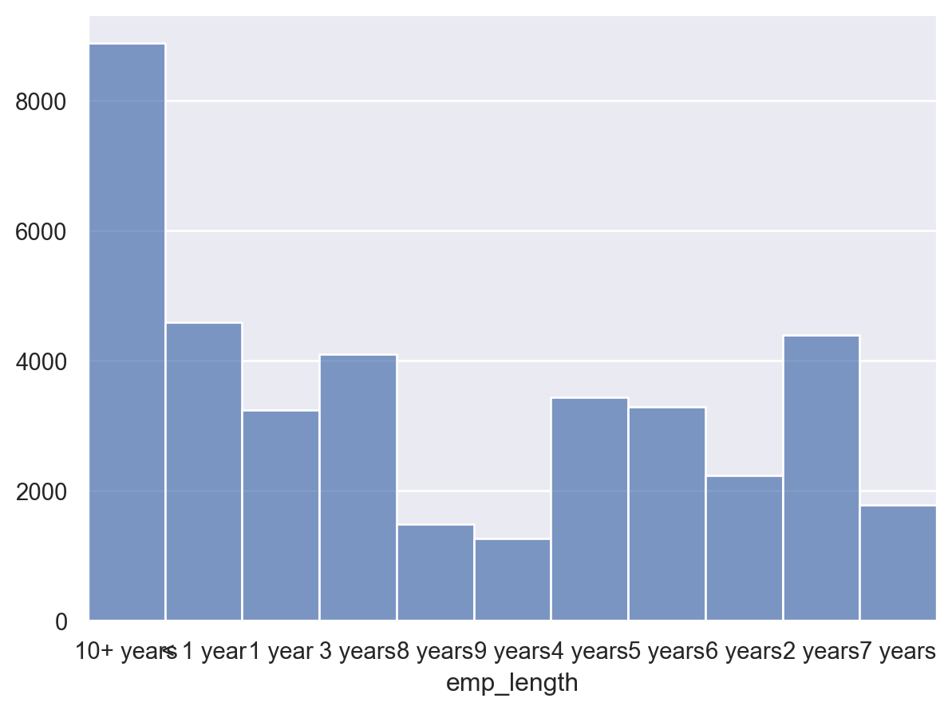
Analysis Approach – key characteristics of the loans issued
Univariate Analysis #5 - Number of loans by length of employment
Maximum number of loans are availed by customers who are employed for 10+ years. The next highest bin is of the customers who are employed between 1 and 2 years

Slide 7
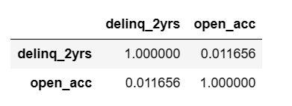
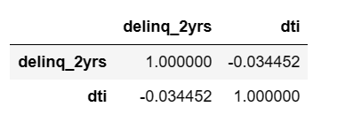
Analysis Approach – key characteristics of the loans issued
Bivariate Analysis #1 - Correlation between the delinquency and the number of open credit lines
Bivariate Analysis #2 - Correlation between the delinquency and the dti
Number of open credit lines has a positive correlation with delinquency although not very strong. However more number of open credit lines increases the risk profile of the customer.
In the given dataset, dti is found to be lower in the delinquent cases.
Lower dti is a strong indicator of a possible default as it indicates lower debt repayment capacity of the borrower.

Slide 8
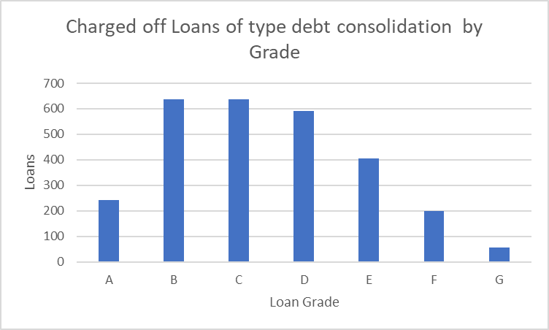
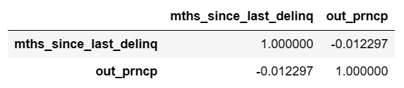
Analysis Approach – key characteristics of the loans issued
Bivariate Analysis #3 - Correlation between the delinquency and the principal outstanding
Bivariate Analysis #4 - Charged off Loans of type debt consolidation by Grade
Plotted in xls
Months since delinquency is inversely correlated with the repayment. recent delinquencies indicates chances of default
Maximum number of charged off loans for the purpose of debt consolidation are of grade B.
More caution to be exercised on the loan applications with these attributes

Slide 9
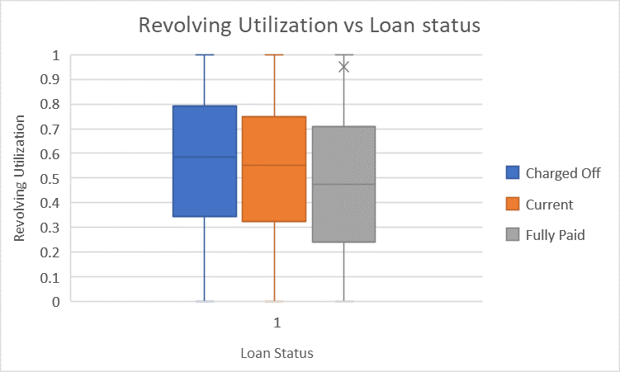
Analysis Approach – key characteristics of the loans issued
Bivariate Analysis #5 - Revolving Utilization vs Loan status
Revolving utilization that indicates risk profile based on the balances on the revolving accounts as against the available credit.
The Median value of the Revolving utilization in case of the Charged off loans was close to 60%.
The Median value of the Revolving utilization in case of the Fully paid loans was under 50%.
The currently running loans have the Median value for Revolving utilization is very near to the Median of Charged off loans.
This is a strong indicator of possible default.
Plotted in xls

Slide 10
Thank You

